Slide 1
Advanced
Web Scraping + Search
Artjola Meli
Shradha Godse

Slide 2
Project Structure
MySQL
Python Application
Web Browser GUI
(Manages user interactions)
MY_CUSTOM_BOT Database
myapp.py script
index.html + results.html
Central storage for search URLs and frequencies
Interacts with the database to fetch and store data
URL data extraction and data processing using Selenium for automated web scraping
index.html: Takes user input for search terms
results.html: Displays search results fetched from the database

Slide 3
Technologies Used
01
MySQL - Database
Insert the search results
Store the URLs and Frequency
Display the URLs and Frequency
02
Routing and View Functions
Integration with Selenium & MySQL
Server Configuration & Error Handling
Flask Framework
03
Selenium
Web Browser Automation
Fetching & Scraping URLs from Search Engines
Handling Pagination
04
BeautifulSoup
HTML Parsing
Data Extraction
Enhancing Data Quality

Slide 4
Duplicate Elimination Logic
Database Primary Key Constraint:
Primary Key on URL:
The URL field is set as the primary key in the database.
This constraint automatically prevents duplicate URLs from being inserted.
In-Memory Check:
Session-Based List:
During each session, maintain a list of URLs already collected and before adding a new URL, check if it already exists.
This immediate check ensures no duplicates within the same scraping session.

Slide 5
Advertisement Elimination Logic
HTML Tag Selection:
Target tags (<h3>, <h4>) used for organic results.
Avoid structures or markers indicating ads.
CSS Selector Waiting:
Wait for elements that indicate organic results.
Avoid partial results and late-loading ads.
URL Pattern Filtering:
Extract URLs with patterns typical for organic results.
Skip URLs with ad-related parameters or structures.
Ad Marker Exclusion:
Identify and skip elements indicating advertisements.

Slide 6
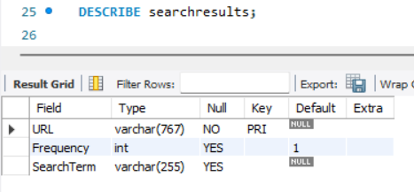
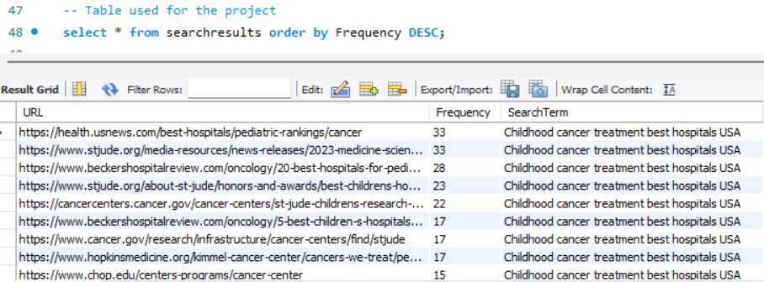
MY_CUSTOM_BOT Database
Table Description
Table Result

Slide 7
Implementation Workflow
User Searches a Term
Setup Selenium Webdriver
Iterate through Search Engines
Fetch and Parse Results
Display Results on GUI
Store in Database
Extract and Filter Data
Screenshot Documentation

Slide 8
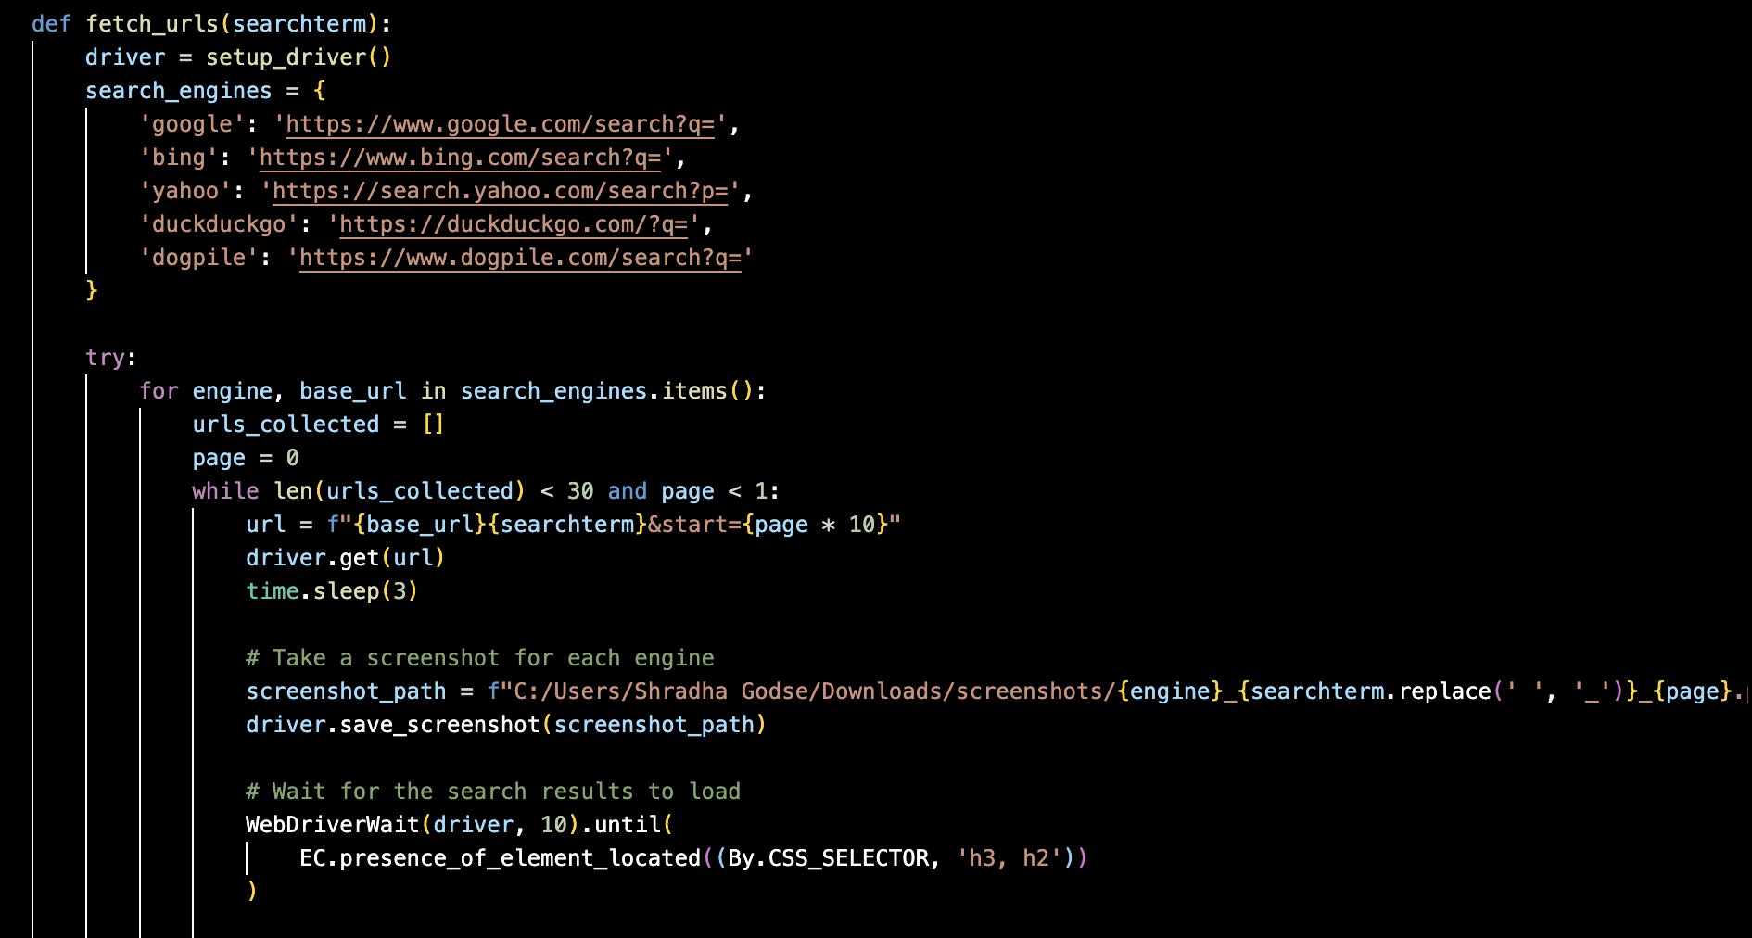
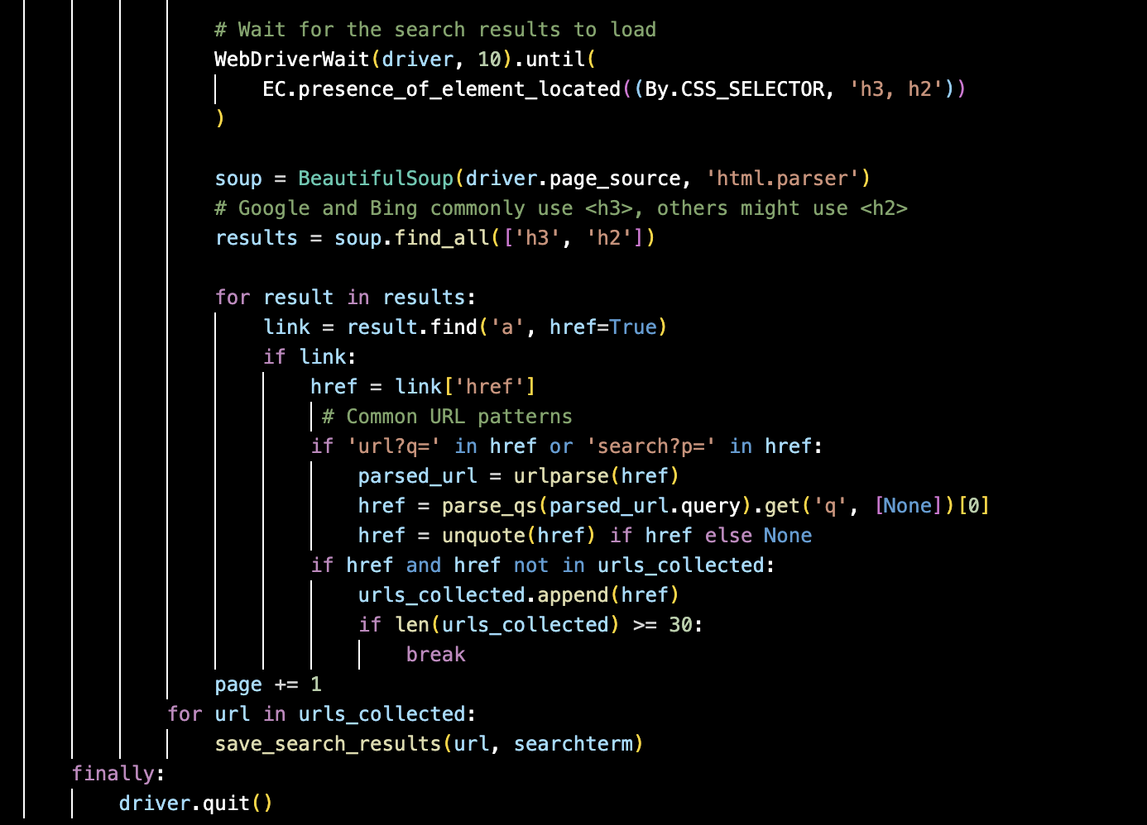
Fetch URL function

Slide 9
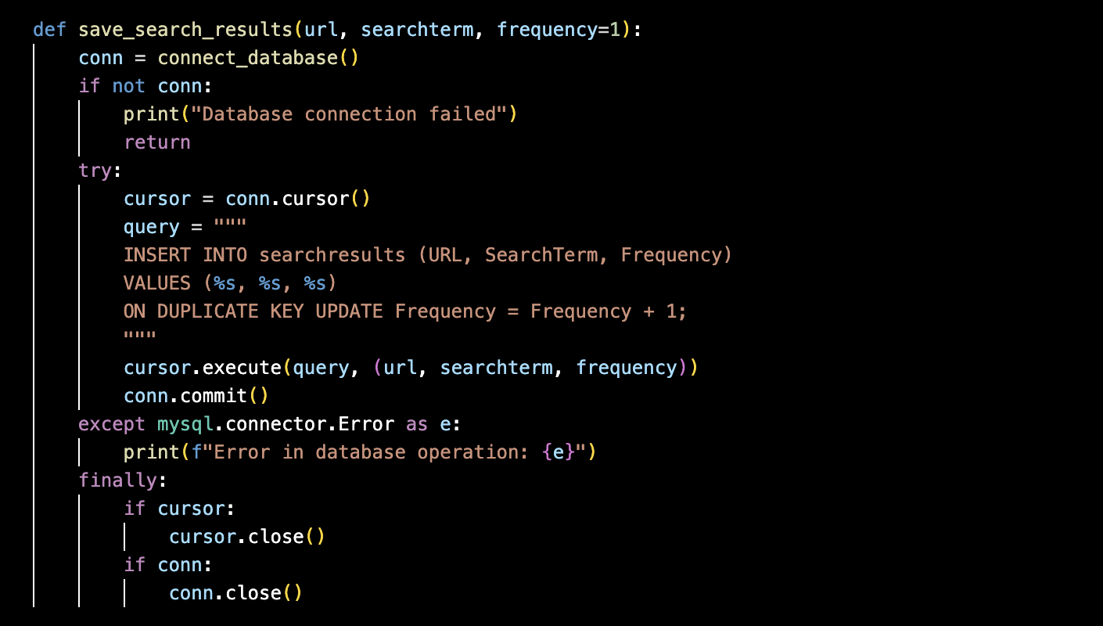
Saving Search Results

Slide 10
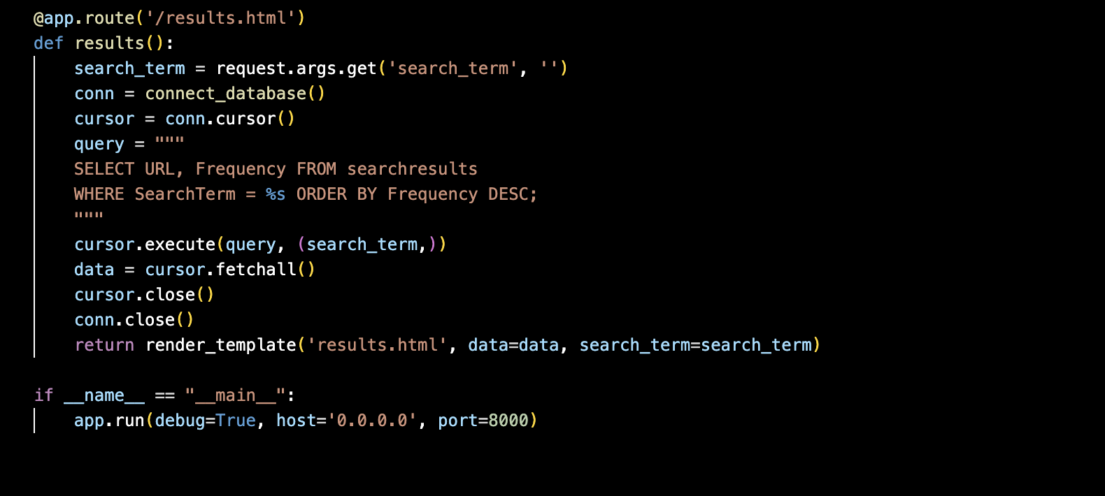
Display Search Results

Slide 11
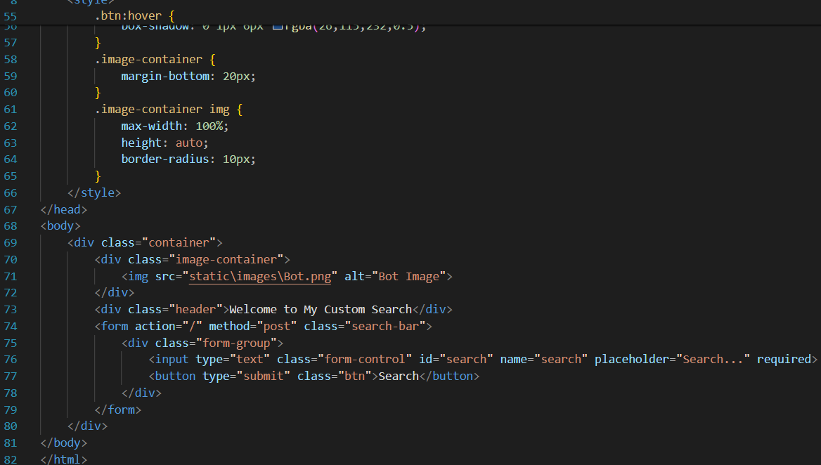
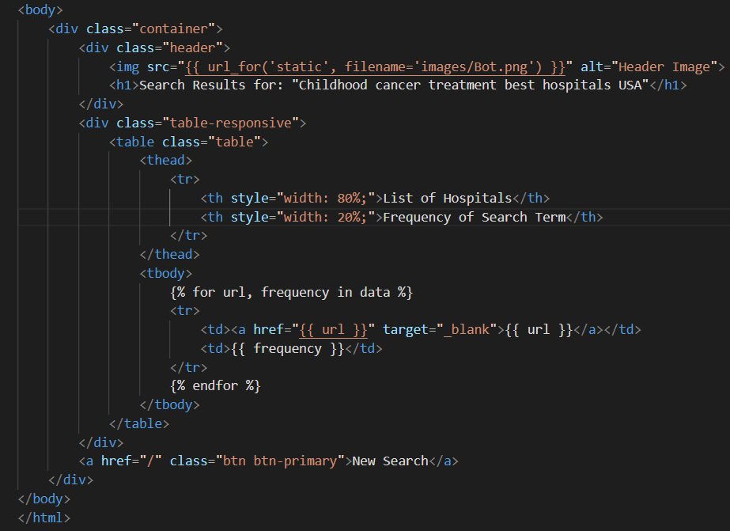
index.html results.html

Slide 12
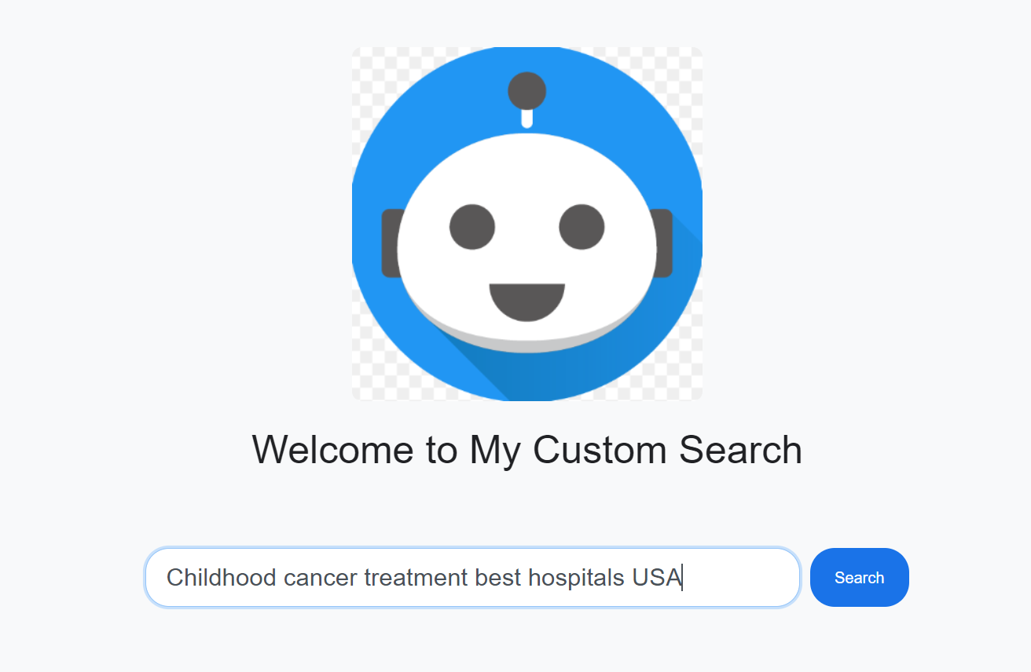
GUI Search Page

Slide 13
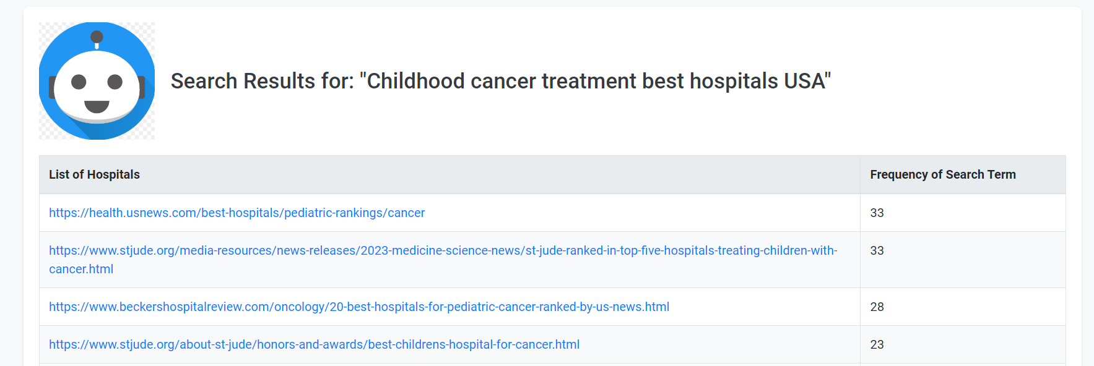
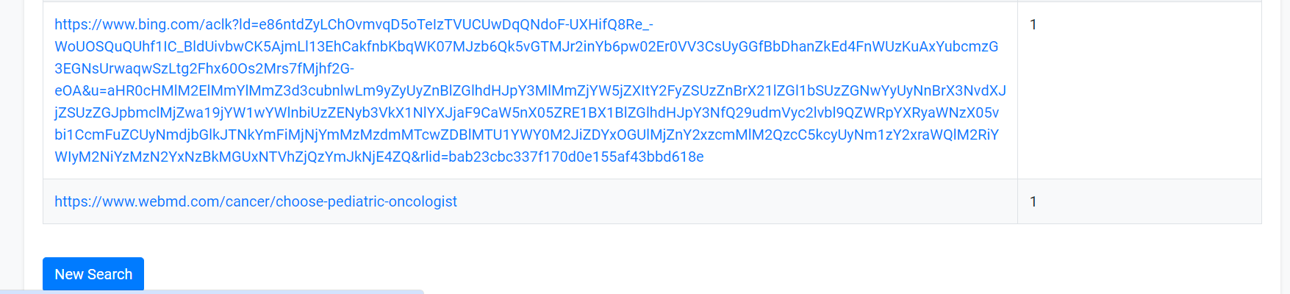
GUI Results Page

Slide 14
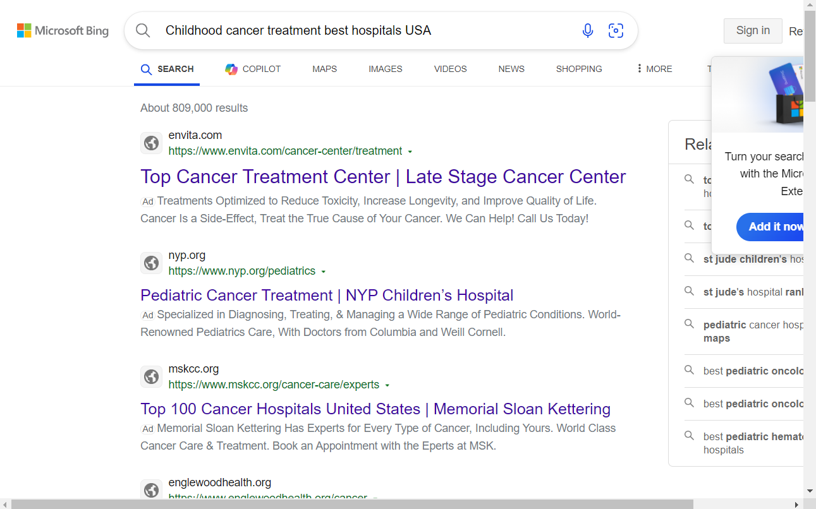
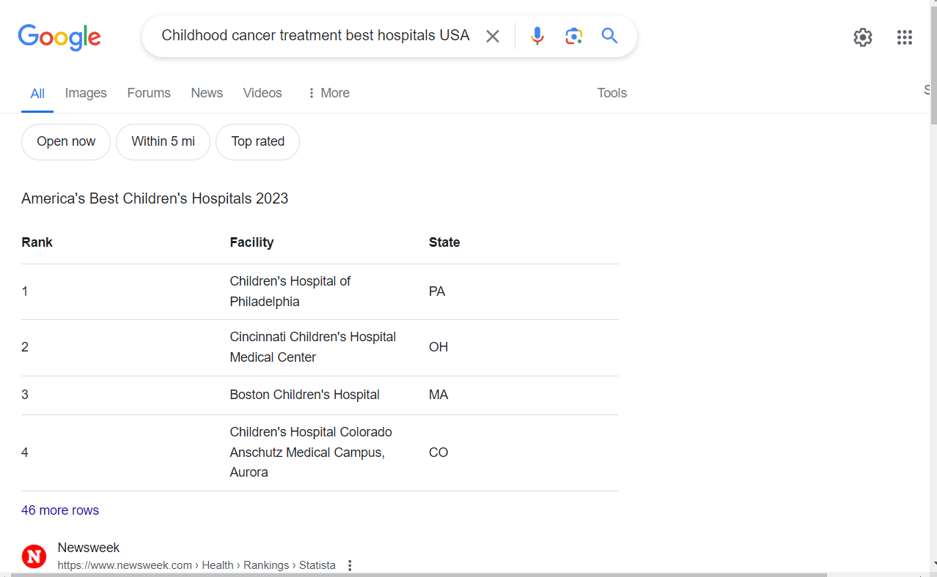
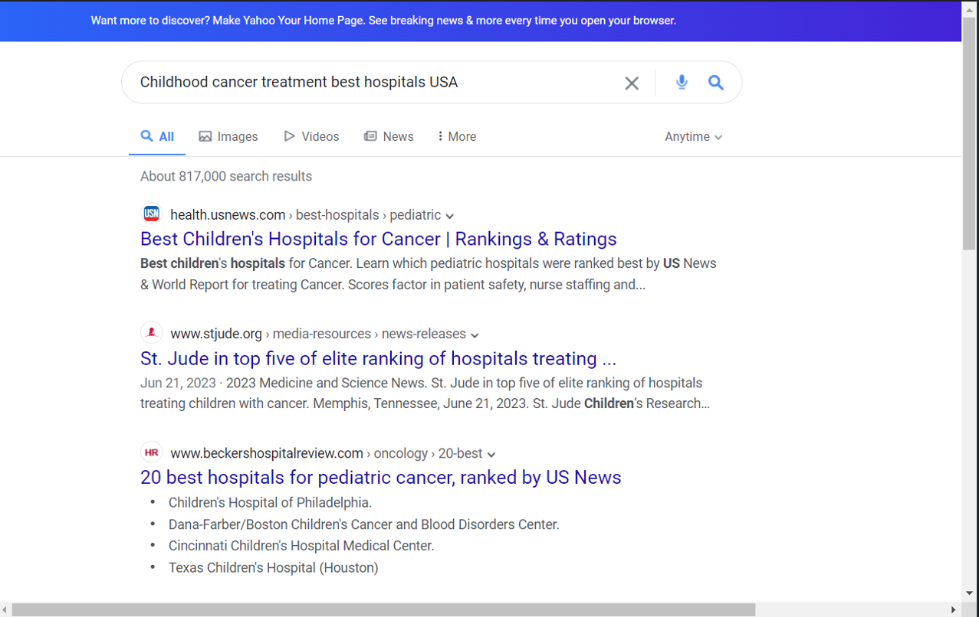
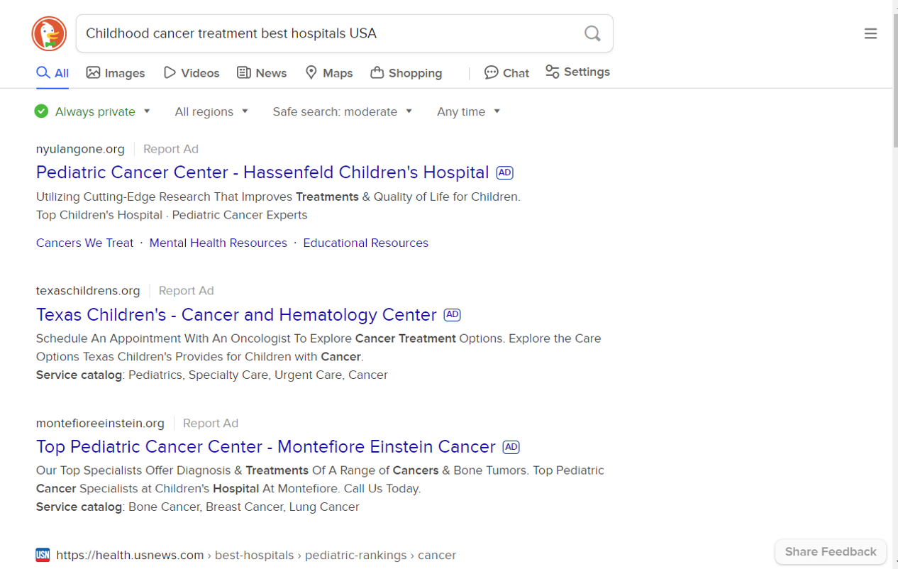
Screenshot Saves using Selenium

Slide 15
Work Division
20%
30%
30%
20%
Web Scraping & DB Setup
HTML Parsing & Filtering
Data Retrieval & Display
Testing & Debugging
Conduct thorough testing to ensure all functionalities work as expected.
Debug any issues that arise during testing.
Configure Selenium for automated web browsing in Flask.
Set up functions to perform searches across search engines.
Use BeautifulSoup to parse search result pages.
Filter out duplicates and advertisements based on defined criteria.
Develop methods to fetch stored search results from the database.
Implement functionality to display results on the GUI.
Shradha
Artjola
Shradha
Artjola
Shradha
Artjola
Shradha
Artjola

Slide 16
Summary
Efficiently fetches relevant URLs while avoiding duplicates and ads.
Ensures high-quality search results for user queries.
Benefits:
Combines database constraints and HTML parsing for effective filtering.
Delivers clean and relevant search results based on the count of frequency search terms on the GUI Browser.

Slide 17

Demo

